Slide 1


Presented By:
Consultation Education and Training Division (CET)
Michigan Occupational Safety & Health Administration (MIOSHA)
Michigan Department of Licensing and Regulatory Affairs(LARA)
www.michigan.gov/miosha
(517) 284-7720
Notes:
Photo from http://coverpassion.com/extreme-sports.html

Slide 2
Job Safety Quiz
The law says your employer is responsible for providing you with a safe and healthy workplace.
True False
The law sets limits on how late you can work on a school night if you are under 16.
True False
If you are 16 years old you are allowed to drive a car on public streets as part of your job.
True False

Slide 3
Job Safety Quiz (continued)
If you are injured on the job, your employer must pay for your medical care.
True False
How often do teens get injured on the job in the United States?
One per day One per hour
One every 9 minutes

Slide 4
Extreme Safety Training Objectives
Review teen worker injury statistics.
Identify where teens work and why they are injured at high rates.
Discuss common health and safety hazards on the job
Identify ways to reduce or control workplace hazards
Learn how to respond to Emergencies in the workplace
Learn the legal rights and responsibilities young people have at work

Slide 5


Why Do Teens Work?
MONEY!!!!
  Work experience
  Independence
  Parental influence

Slide 6

Teens Do Get Hurt & Sick On The Job
Teens are injured at higher rates than adults.
About 70,000 teens go to a hospital emergency room for treatment of a workplace injury.
This isn’t about “accidents” – the problem is UNSAFE WORKPLACES !!!
A teen remained in intensive care after his arm became stuck in a roller brush that cleans snow from a ski conveyor lift

Slide 7
Teen Worker Injury Statistics
Where Teens are Injured on the Job:
% of total workers, aged 15-17, per industry
*Includes restaurants.
These data are for injuries that require at least one day away from work. They do not include youth who work on small farms, work for government agencies, or are self-employed.
Source: NIOSH / CDC 2009 (www.cdc.gov/niosh/topics/youth/chartpackage.html)

Slide 8
Teens Injury Statistics
Teens are injured at higher rates than adults.
230,000 teens are injured at work annually.
100,000 teens visit the emergency room due to work related injuries.
88 youths under age 20 died from work-related injuries in 2010, while 20,000 missed work in private industry due to occupational-related illness or injury
Fatal work injuries involving workers under 16 years of age nearly doubled, rising from 10 in 2011 to 19 in 2012.
68 TEENS ARE KILLED ON THE JOB EACH YEAR
One Teen Every 9 Minutes
Notes:
Statistics taken from NIOSH.gov, Public Health Reports, and Centers for Diseases Control
YOUNG WORKER SAFETY AND HEALTH
In 2013, there were approximately 18.1 million workers less than 24 years of age, and these workers represented 13% of the workforce. Young workers have high occupational injury rates which are in part explained by a high frequency of injury hazards in workplaces where they typically work (e.g. hazards in restaurant settings associated with slippery floors and use of knives and cooking equipment). Inexperience and lack of safety training may also increase injury risks for young workers. And, for the youngest workers, those in middle and high schools, there may be biologic and psychosocial contributors to increased injury rates, such as inadequate fit, strength, and cognitive abilities to operate farm equipment such as tractors.
In 2012, 375 workers less than 24 years of age died from work-related injuries, including 29 deaths of youth less than 18 years of age. For the 10 year period 1998 to 2007, there was an annual average of 795,000 nonfatal injuries to young workers treated in U.S. hospital injury departments. The rate for emergency department-treated occupational injuries of young workers was approximately two times higher than among workers 25 years and older. The U.S. Public Health Service has a Healthy People objective to reduce rates of occupational injuries treated in emergency departments among working adolescents 15-19 years of age by 10% by 2020, from the 2007 rate of 4.9 injuries per 100 fulltime equivalent workers.

Slide 9
Young Workers Get Hurt When:
They don’t have appropriate supervision
They perform jobs for which they are not trained – sometimes without being asked
They work with dangerous tools or equipment
They are required to perform tasks that violate youth labor laws
Notes:
Young workers are often eager to please and will attempt to perform tasks for which they have not received training, or even been asked to do.
Young workers may seem confident and responsible, and therefore not supervised as closely as they need to be.
On the other hand they may be asked or required to work with dangerous tools or equipment, performing tasks that violate youth employment laws
High turnover jobs
Speed-up
Stressful conditions
Inexperience
Poor safety training
Lack of supervision
Want to be responsible and appear competent

Slide 10
Work in Violation of Labor Laws:
Too many hours
In prohibited hazardous occupations
Without work permits
Age of Attendance
WORK ALERT
Michigan requires Teens to have a valid permit to work.
Schools, employers, and parents are part of the permit process
Notes:
Contact Department of Education for additional information
Age of Attendance -Kids must be in school ages 6-18, unless they meet one of the three exemptions under MCL 380.1561

Slide 11
In Michigan, Workers Under 18 May Not:
Drive a motor vehicle as part of the job.
Drive a forklift.
Use power driven equipment, saws or machinery.
Slaughtering, butchering and meat cutting.
Work in construction.
Come in contact with hazardous substances.
Work in logging or sawmill.
Perform brazing, welding, soldering or heat treating.
Notes:
For more information on the permitted and prohibited work activities for teens, permitted numberof work hours for teens, and on work permits contact the Michigan Department of Education, Office of Career and Technical Education at 517.335.6041
Drive a motor vehicle as part of the job (pizza delivery, etc).
Use power driven equipment, saws or machinery (box crusher, circular saw, meat slicer, woodworking machinery, bakery machines, paper product machines, metal-forming, punching and shearing machines).
Perform brazing, welding, soldering or heat treating (those less than 16 years of age).
Work in construction, wrecking, demolition, excavation, bridges or roofing.
Come in contact with hazardous substances, chemicals, explosives or radioactive substances

Slide 12
Restricted Work
Special approval for some restricted work for 16 and 17-year-olds may be authorized. Employers must apply for special approval to the Department of Education.
Call (517) 335-6041 or visit MDE Office of Career & Technical Education-Youth Employment website at www.michigan.gov/mde
Notes:
Employees under 18 years of age must obtain a work permit or have their school complete a training agreement before starting work. Work permits can be obtained from the school the minor attends or the school district where the minor will be employed. If the minor changes jobs, a new work permit is required for the new employer. A work permit may be revoked for poor academic performance. A work permit is required even if the minor does not attend school.
Work permits are no longer available for bulk purchase from Michigan Center for Career & Technical Education; work permits are available for printing or download from the 'Related Documents' section below. Note: CA-6 work permits must be printed on pink paper and CA-7 work permits must be printed on yellow paper. To be valid both CA-6 and CA-7 must have the front and back pages of the work permit printed.
Youth Employment Forms Packet
Youth Employment Standards Act
Standards for Issuance of Work Permits
Legislative link to the Youth Employment Standards Act

Slide 13

http://www.youtube.com/watch?v=lBT4-EXqddo&feature=related
Notes:
Clip is a funny video of a model falling down on the runway. This is a funny clip but workplace hazards are not Funny
Hazards can be present on every job and you have to recognize them and protect employees from them.

Slide 14
Job Hazards
A job hazard is anything at work that can hurt you either physically or mentally.
Every job has health and safety hazards
Training should always be provided to make you aware of the hazards in your workplace
Agriculture
https://www.osha.gov/SLTC/youth/agriculture/index.html
  MI AG Fatality
    2004MI176-MI 6-year-old youth dies when he was run over by a skid-steer loader driven by his 9-year-old brother.
Notes:
Agriculture is one of the most dangerous industries in the nation. Each year, more than 2 million youth under the age of 20 are exposed to farm-related safety hazards. As a result, a significant number of young people are killed, injured or permanently disabled on farms in the United States. This OSHA eTool describes common agricultural hazards and offers potential safety solutions that both employers and young workers can utilize to prevent accidents and avoid injury on the job.
Agricultural Hazards:
Tractors
Electrocution
Confined Spaces
Other Machinery
Organic Dust
Struck-by
Falls
Chemicals
Workers/Pickers
Tractors
Other Machinery
Struck-by
Falls
Electrocution
Confined Space
Chemicals
Workers/Pickers
Organic Dust

Slide 15
Recognizing Job Hazards
Safety hazards can cause immediate accidents and injuries.
  Examples: Hot surfaces, slippery floors, sharp knives, hot grease, violence.
Chemical hazards are gases, vapors, liquids, or dusts that can harm your body.
  Examples: cleaning products.

Slide 16
Recognizing Job Hazards
Biological hazards are living things that can cause sickness or disease.
  Examples: Bacteria, animals, used needles, and poison ivy.
Other health hazards are harmful things, not in other categories, that can injure you or make you sick. They are sometimes less obvious because the y do not cause health problems right away.
  Examples: noise, heat, cold, heavy lifting, awkward posture, and harassment.

Slide 17

Making the Job Safer
The best way to prevent a workplace injury or illness is to remove the hazard. If this can’t be done, then hazards can be controlled through work policies and procedures or the use of PPE (personal protective equipment), such as a respirator or hearing or eye protection.
Personal protective equipment is not usually the best way to protect workers because the hazard is still there, and because the equipment has to fit right and be used every time.
A good way to think about addressing hazards in the workplace is, “Fix the workplace, not the worker.”

Slide 18


Protection from Hazards
Engineer the hazard out
Utilize administrative procedures
Provide personal protective equipment

Slide 19
Common Workplace Safety and Health Hazards
Materials Handling
Electrical Equipment
Slips, Trips and Falls
Chemical Exposure
Poor Housekeeping
Lack of Emergency Procedures
Lack of Personal Protective Equipment
Noise
Notes:
The next few slides will introduce some minimum information and training most employers will need to provide to employees before they begin work.
These standards are ones that most employers will need to comply with.

Slide 20
Materials Handling
Ergonomic Job Risk Factors
Awkward postures
Forceful exertions
Repetitive motions
Duration
Contact stresses
Vibration
Other
Notes:
Ergonomic Job Risk Factors
Awkward postures
Forceful exertions
Repetitive motions
Duration
Contact stresses
Vibration
Other
Temperature
Work pace, recovery time
Machine paced work
Unfamiliar or unaccustomed work
Psychological stressors

Slide 21
Electrical Hazard Protection
Inspect electrical equipment/cords regularly
Remove damaged equipment/cords from service
Report electrical problems
No Wet Hands!
No Unapproved equipment
No extension cords under rugs or across walkways
Don’t overload circuits
Never string two extension cords together-FIRE HAZARD
Extension cords are not for longterm use
Notes:
Reference the Electrical hazards handout.

Slide 22
Slips, Trips & Falls
Top cause of employee injuries
  Standing on chairs
  Falling out of chairs
  Falling down stairs
  Uneven surfaces
  Wet/slippery surfaces
  Cluttered/obstructed aisleways

Slide 23

Preventing Slips, Trips, & Falls
Keep aisles clear/unobstructed
Use the handrail on stairs
Hold onto chair arms/seat when attempting to sit
Use an approved step ladder/stool
Wear appropriate shoes
Wipe up/report spills/Use wet floor signs
Report deficiencies to maintenance
“Penguin Walk” on slippery surfaces

Slide 24

Workplace Chemicals
Cleaning products and maintenance supplies
Copier/printer toners and inks
Markers used for white boards and flip charts
White board cleaner
Paper correction fluids
Laboratory Hazards
Notes:
Accidents in the laboratory are often the result of carelessness or ignorance either by you or by your neighbors. Stay alert and pay constant attention to your own and to your neighbors' actions. The safety precautions outlined below will be worthless unless you plan, understand, and think through the consequences of every operation before you perform it. The common accidents, which often occur simultaneously, are fire, explosion, chemical and thermal burns, cuts from broken glass tubing and thermometers, absorption of toxic, but non-corrosive chemicals through the skin, and inhalation of toxic fumes. Less common, but obviously dangerous, is the ingestion of a toxic chemical. Each of these types is discussed in a general way below, and more specific reference to certain hazards will be found in the individual experiments.
1. Fire. There should never be open flames in the lab. Make it a working rule that water is the only nonflammable liquid you are likely to encounter. Treat all others in the vicinity of a flame as you would gasoline. Specifically, never heat any organic solvent in an open vessel, such as a test tube, Erlenmeyer flask, or beaker, with a flame. Such solvents should be heated in a hood with a steam bath, not a hot plate. Never keep volatile solvents, such as ether, acetone, or benzene in an open beaker or Erlenmeyer flask. The vapors can and will creep along the bench, ignite, and flash back if they reach a flame or spark.
It is your responsibility to yourself and to your neighbors to know where the nearest safety shower and fire extinguisher are located. TAs are trained in the use of fire extinguishers.
2. Explosion. Never heat a closed system or conduct a reaction in a closed system (unless specifically directed to perform the latter process and then only with frequent venting). Before starting a distillation or a chemical reaction, make sure that the system is vented. The results of an explosion are flying glass and spattered chemicals, usually both hot and corrosive.
3. Chemical and Thermal Burns. Many inorganic chemicals such as the mineral acids and alkalis are corrosive to the skin and eyes. Likewise, many organic chemicals, such as acid halides, phenols, and so forth are corrosive and often toxic. If these are spilled on the desk, in the hood, or on a shelf, call for assistance in cleaning them up.
Be careful with hot plates to avoid burns. Always assume that hot plates are HOT.
4. Cuts. The most common laboratory accident is probably the cut received while attempting to force a cork or rubber stopper onto a piece of glass tubing, a thermometer, or the side-arm of a distilling flask. Be sure to make a proper-sized hole, lubricate the cork or stopper (lubrication is essential with a rubber stopper), and use a gentle pressure with rotation on the glass part. Severed nerves and tendons are common results of injuries caused by improper manipulation of glass tubes and thermometers. Always pull rather than push on the glass when possible.
5. Absorption of Chemicals. Keep chemicals off the skin. Many organic substances are not corrosive, do not burn the skin, or seem to have any serious effects. They are, however, absorbed through the skin, sometimes with dire consequences. Others will give a serious allergic reaction upon repeated exposure, as evidenced by severe dermatitis. Be careful about touching your face or eyes in the lab; make sure your hands are clean first. Gloves will be available in the lab. However, gloves provide only a temporary layer of protection against chemicals on your skin and may be permeable to some chemical reagents, without visible deterioration. If your gloves come in contact with a chemical reagent, remove them, wash your hands, and get a new pair immediately.
6. Inhalation of Chemicals. Keep your nose away from chemicals. Many of the common solvents are extremely toxic if inhaled in any quantity or over a period of time. Do not evaporate excess solvents in the laboratory; use the hood or a suitable distillation apparatus with a condenser. Some compounds, such as acetyl chloride, will severely irritate membranes in your eyes, nose, throat, and lungs, while others, such as benzyl chloride, are severe lachrymators, i.e. they induce eye irritation and tears. When in doubt, use the hood or consult with the laboratory instructor about the use of chemicals required for your work. Specific safety information about chemicals used is included in each experiment write up. MSDS (Material Safety Data Sheets) are available on the DCIS file server and summarize safety information about substances used in the lab.
7. Ingestion of Chemicals. The common ways of accidentally ingesting harmful chemicals are: (1) by pipet, (2) from dirty hands, (3) contaminated food or drink and (4) food use of chemicals taken from the laboratory. Below are ways to avoid accidental ingestion of chemical reagents.
• Pipets must be fitted with suction bulbs to transfer chemicals. DO NOT USE MOUTH SUCTION.
• Wash your hands before handling anything (cigarettes, chewing gum, food) which goes into your mouth. Wash your hands when you leave the laboratory.
• Do not eat or drink in the laboratory. Use the water fountains for a drink--not a laboratory faucet. Remove gloves and wash your hands before using the water fountain or bathroom.
• Never use chemicals (salt, sugar, alcohol, bicarbonate, etc.) from the laboratory or stockroom on food. The source containers may be contaminated or mislabeled.
• Never use laboratory glassware as a food or drink container.
• Never store food or drink in a laboratory refrigerator or ice machine. Never consume ice from a laboratory ice machine.

Slide 25
Hazard Communication
Enacted to provide you with access to information
on the health and physical hazards of the chemicals
In your workplace to which you are exposed.
The employer must develop and have available for employee review a written hazard communication program.
http://www.michigan.gov/lara/0,4601,7-154-61256_11407-284831--,00.html
Notes:
Take them to our website to view the hazcom page and resources.

Slide 26
Effects of Excessive Noise
Increase heart rate & blood pressure
Constriction of blood vessels leading to tension & stress
Nervousness, sleepiness & fatigue
Notes:
Noise and it’s physiological effects on the body is a hazard often overlooked
Rule of Thumb: If you have to shout to be heard by someone an arm’s length away the noise decibel level is probably close to or at the action level.

Slide 27
Noise Standard Requirements
Engineering, administrative, &/or PPE controls required
> 90 dBA
Noise monitoring
Employee training
Audiometric tests
Provide PPE
Recordkeeping
Posting
> 85 dBA
& < 90dBA
< 85 dBA
No mandatory requirements
8-hour TWA

Slide 28
Personal Protective Equipment
An Employer Shall:
Assess the workplace to determine hazards present
Select PPE needed and required to perform the job
Communicate selection decision to employees
  Safe, reliable & sanitary
  Clean, inspect & maintain
No cost to employee either initial issue or replacement costs
Verify written PPE assessment certification which includes:
  Workplace evaluated
  Person who certified assessment
  Date of hazard assessment completion
Notes:
Part 33/433/6.
Great place to do the coin stacking exercise if time permits. You will need 8 quarters, 20 dimes, 20 nickels, 40 pennies. Half of the coins go to two competitors. You give them three trials of 15 -20 seconds. Each time wearing a different type of glove. Most stacked wins a MIOSHA something and a candy bar (optional because the instructor must purchase the candy). Discuss which pair of gloves easiest to stack in. Emphasize the importance of selecting the right PPE and size for the Job.

Slide 29
Lab Safety
Notes:
Fun video that gives the five rules of safety for labs. Run time 11 minutes
Accidents in the laboratory are often the result of carelessness or ignorance either by you or by your neighbors. Stay alert and pay constant attention to your own and to your neighbors' actions. The safety precautions outlined below will be worthless unless you plan, understand, and think through the consequences of every operation before you perform it. The common accidents, which often occur simultaneously, are fire, explosion, chemical and thermal burns, cuts from broken glass tubing and thermometers, absorption of toxic, but non-corrosive chemicals through the skin, and inhalation of toxic fumes. Less common, but obviously dangerous, is the ingestion of a toxic chemical. Each of these types is discussed in a general way below, and more specific reference to certain hazards will be found in the individual experiments.
1. Fire. There should never be open flames in the lab. Make it a working rule that water is the only nonflammable liquid you are likely to encounter. Treat all others in the vicinity of a flame as you would gasoline. Specifically, never heat any organic solvent in an open vessel, such as a test tube, Erlenmeyer flask, or beaker, with a flame. Such solvents should be heated in a hood with a steam bath, not a hot plate. Never keep volatile solvents, such as ether, acetone, or benzene in an open beaker or Erlenmeyer flask. The vapors can and will creep along the bench, ignite, and flash back if they reach a flame or spark.
It is your responsibility to yourself and to your neighbors to know where the nearest safety shower and fire extinguisher are located. TAs are trained in the use of fire extinguishers.
2. Explosion. Never heat a closed system or conduct a reaction in a closed system (unless specifically directed to perform the latter process and then only with frequent venting). Before starting a distillation or a chemical reaction, make sure that the system is vented. The results of an explosion are flying glass and spattered chemicals, usually both hot and corrosive.
3. Chemical and Thermal Burns. Many inorganic chemicals such as the mineral acids and alkalis are corrosive to the skin and eyes. Likewise, many organic chemicals, such as acid halides, phenols, and so forth are corrosive and often toxic. If these are spilled on the desk, in the hood, or on a shelf, call for assistance in cleaning them up.
Be careful with hot plates to avoid burns. Always assume that hot plates are HOT.
4. Cuts. The most common laboratory accident is probably the cut received while attempting to force a cork or rubber stopper onto a piece of glass tubing, a thermometer, or the side-arm of a distilling flask. Be sure to make a proper-sized hole, lubricate the cork or stopper (lubrication is essential with a rubber stopper), and use a gentle pressure with rotation on the glass part. Severed nerves and tendons are common results of injuries caused by improper manipulation of glass tubes and thermometers. Always pull rather than push on the glass when possible.
5. Absorption of Chemicals. Keep chemicals off the skin. Many organic substances are not corrosive, do not burn the skin, or seem to have any serious effects. They are, however, absorbed through the skin, sometimes with dire consequences. Others will give a serious allergic reaction upon repeated exposure, as evidenced by severe dermatitis. Be careful about touching your face or eyes in the lab; make sure your hands are clean first. Gloves will be available in the lab. However, gloves provide only a temporary layer of protection against chemicals on your skin and may be permeable to some chemical reagents, without visible deterioration. If your gloves come in contact with a chemical reagent, remove them, wash your hands, and get a new pair immediately.
6. Inhalation of Chemicals. Keep your nose away from chemicals. Many of the common solvents are extremely toxic if inhaled in any quantity or over a period of time. Do not evaporate excess solvents in the laboratory; use the hood or a suitable distillation apparatus with a condenser. Some compounds, such as acetyl chloride, will severely irritate membranes in your eyes, nose, throat, and lungs, while others, such as benzyl chloride, are severe lachrymators, i.e. they induce eye irritation and tears. When in doubt, use the hood or consult with the laboratory instructor about the use of chemicals required for your work. Specific safety information about chemicals used is included in each experiment write up. MSDS (Material Safety Data Sheets) are available on the DCIS file server and summarize safety information about substances used in the lab.
7. Ingestion of Chemicals. The common ways of accidentally ingesting harmful chemicals are: (1) by pipet, (2) from dirty hands, (3) contaminated food or drink and (4) food use of chemicals taken from the laboratory. Below are ways to avoid accidental ingestion of chemical reagents.
• Pipets must be fitted with suction bulbs to transfer chemicals. DO NOT USE MOUTH SUCTION.
• Wash your hands before handling anything (cigarettes, chewing gum, food) which goes into your mouth. Wash your hands when you leave the laboratory.
• Do not eat or drink in the laboratory. Use the water fountains for a drink--not a laboratory faucet. Remove gloves and wash your hands before using the water fountain or bathroom.
• Never use chemicals (salt, sugar, alcohol, bicarbonate, etc.) from the laboratory or stockroom on food. The source containers may be contaminated or mislabeled.
• Never use laboratory glassware as a food or drink container.
• Never store food or drink in a laboratory refrigerator or ice machine. Never consume ice from a laboratory ice machine.

Slide 30
Emergencies at Work
What is an emergency at work?
An unplanned event that harms or threatens employees, customers, or the public; that shuts down business operations; or that causes physical or environmental damage

Slide 31
Emergencies
Know the emergency action plan
Know the escape routes
Never block or lock emergency exits
Know how to use fire extinguishers
Keep an eye on heat generating appliances
  Toasters
  Microwaves
  Space heaters

Slide 32
Emergency Action Plans
Many workplaces need an emergency action plan. Workers should receive training on the plan.
The plan should include information about
  Different emergencies and how to respond
  Locations of meeting places
  Evacuation routes
  Emergency equipment and alert systems
  Key personnel (who’s in charge)
  Procedures to follow when someone is injured
  Individual worker responsibilities
  Practice drills

Slide 33
MIOSHA Fact Sheets For Young Workers
Retail Industry
Construction Industry
Landscape & Horticultural Services
Restaurant/Fast Food Industry
Electrical Safety-Related Work Practices for Schools
Youth Fatal Facts
Notes:
Direct attendees attention to the handouts of the fact sheets. Briefly review fact sheets on MIOSHA website

Slide 34
Adolescent Aspirations
http://www.youtube.com/watch?feature=player_embedded&v=2NYEi12uiQI#t=3s
Notes:
Play the video clip first (run time 43 seconds). It is a skit done by teens. The skit depicts a young worker being told to use a drill press that the supervisor knows is not working properly. The emphasis is on speaking up.
Information to emphasize after the skit is shown
All youth have aspirations to be SUPER. When it comes to negative things they all believe they are immune…it won’t happen to me, I’m careful. They give into fear, pressure, pride and when their gut tells them something is not right or when they don’t know something , they wont speak up….but they should!!!

Slide 35
Real Jobs, Real Risks
VIDEO & DISCUSSION
Notes:
All youth have aspirations to be SUPER. When it comes to negative things they all believe they are immune…it won’t happen to me, I’m careful. They give into fear, pressure, pride and when their gut tells them something is not right or when they don’t know something , they wont speak up….but they should!!!
Use one of these videos or introduce and discuss the next 8 slides. Instructor determines which depending upon the time and the audience.
Lost Youth
http://www.youtube.com/watch?v=Mlkvyjsxz9A
The First Step
Real jobs Real Risks
http://youtu.be/3rLzCKMHi1E
The instructor should make the following points:
It can happen to you.
There is no such thing as being careful enough. Many injuries are sustained doing relatively simple tasks.
Training on the hazards of a job should be done before an employee performs the job.
If you don’t know, say so!
Lost Youth Video (run time = 15 minutes). Internet access is needed. This is an internet based video from Washington state. Run time of 15 minutes. Very powerful stories of workplace accidents from 4 injured young workers along with the reenactments.
The First Step (run time 5 minutes) is a DVD/youtube. obtain from Lab/or need internet access. Testimonial of one workplace injury and the reenactment.
Real jobs real risks run time 13 minutes. Testimonial of one workplace accident. Very current.

Slide 36
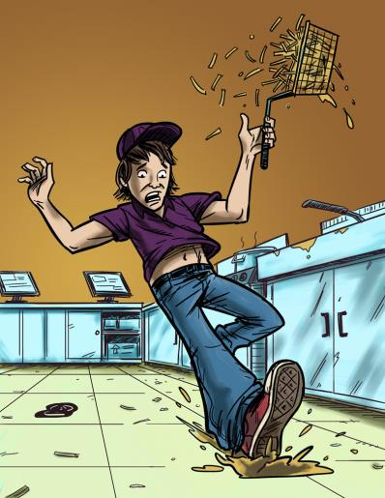
Examples of Teen Work Injuries
Jack’s Story
Job: Fast food worker
Hazard: Greasy, slippery floors
Injury: Injured tailbone
The Impact of Work Injuries
Why do you think this happened?
What could have prevented Jack from getting hurt?
How might this injury impact Jack’s daily life?
Notes:
Jack worked in the kitchen of a fast food restaurant in the evenings after school and on weekends. One Friday
afternoon, Jack had to work the fryer. At one point, Jack walked across the floor, carrying a basket of french fries. He
didn’t see a slick spot on the tile, and he slipped and fell. He landed on his tailbone and was seriously hurt. Jack has pain
that won’t go away, and he has trouble walking and sitting.

Slide 37
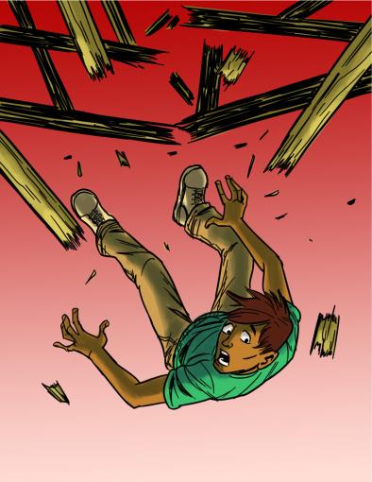
Teen Work Injuries
Antonio’s Story
Job: Construction helper
Hazard: Unguarded chimney hole (on an unfinished roof)
Injury: Broken back
The Impact of Work Injuries
Why do you think this happened?
What could have prevented Antonio from being injured?
How might this injury impact Antonio’s daily life?
Notes:
Antonio, age 17, worked for a neighborhood builder. One day he was carrying a 12-foot roof rafter along the top of an
unfinished house. He backed into an unguarded chimney hole and fell 28 feet to a concrete cellar floor below. He survived,
but the fall cracked three bones in his back. His injury forced him to spend the next 3 months locked in a “clamshell” brace
from his neck to his hips. Because of his age, he shouldn’t have been doing this dangerous work in the first place.

Slide 38
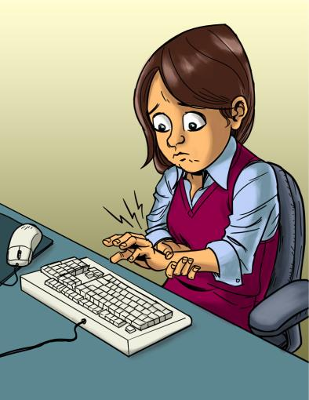
Teen Work Injuries
Angela’s Story
Job: Office worker
Hazard: Excessive typing in an awkward position
Injury: Repetitive stress injury
The Impact of Work Injuries
Why do you think this happened?
What could have prevented Angela from being injured?
How might this injury impact Angela’s daily life?
Notes:
Angela, age 16, did a lot of homework on the computer and spent time every day e-mailing and texting her friends. She
also worked 3 hours a day after school typing data for a direct mail company. Angela was paid by “piece work.” This
means she got paid for how much work she did, and not the time she spent doing it. She never took breaks. Her fingers
started feeling numb, and in the mornings she woke up with a burning feeling in her wrist. Angela’s doctor said she had
severe repetitive stress injury (RSI). This happens when you type in an awkward position, over and over again. The motion
damages muscles, tendons, and nerves. Now she has to wear braces on her wrists and can’t work on a computer for
more than 15 minutes at a time. Angela’s high school has someone take notes in class for her.

Slide 39
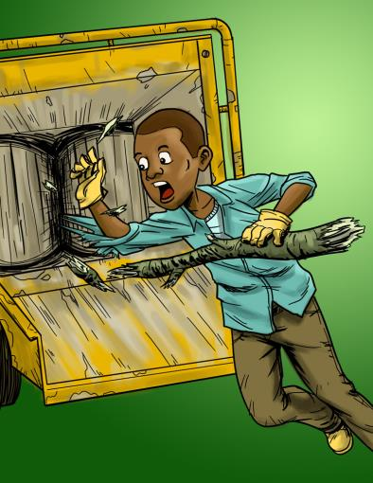
Teen Work Injuries
Terrell’s Story
Job: Landscape worker
Hazard: Wood chipper
Injury: Death
The Impact of Work Injuries
Why do you think this happened?
What could have prevented Terrell from being killed?
Notes:
Terrell was a 15-year-old boy who found work with a landscape company when he moved to Maryland with his
family. After only a week on the job, he was told to help grind up tree branches, using a motorized wood chipper. As he
fed tree trimmings into the machine, Terrell got tangled in some large branches. The machine pulled him into the feed
chute and killed him. A co-worker found his body soon after. He shouldn’t have been doing this work because of his age.

Slide 40
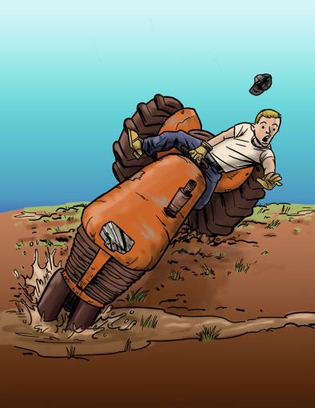
Teen Work Injuries
Cody’s Story
Job: Farm worker
Hazard: Tractor without roll bar
Injury: Legs crushed under tractor
The Impact of Work Injuries
Why do you think this happened?
What could have prevented Cody from getting hurt?
How might this injury impact Cody’s daily life?
Notes:
Cody, age 16, worked on his family’s farm during the summer. One day Cody drove a tractor down a narrow gravel road. The
tractor had no seatbelt or roll bar. He moved too close to the right edge of the road and drove into a ditch. This made the
tractor roll over. When Cody had felt what was happening, he tried to jump, but his boot got caught between the seat
and fender. The tractor’s left tire crushed Cody’s legs, leaving him paralyzed from the waist down.

Slide 41
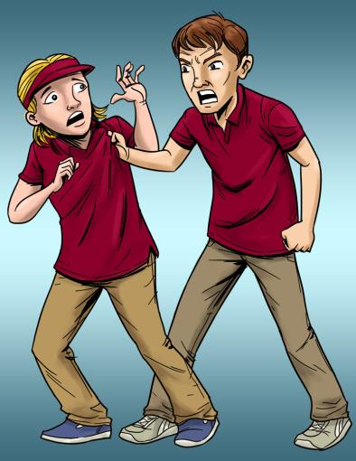
Teen Work Injuries
Lindsey’s Story
Job: Pizza shop cashier
Hazard: Violence (by a co-worker)
Injury: Bumps and bruises caused by abusive co-worker
The Impact of Work Injuries
What could Lindsey's employer have done to stop her abuser?
What would you do in this situation?
How might Lindsey’s life be affected by this incident?
Notes:
Lindsey, a high school sophomore, worked the front counter of a small local pizza shop after school and on weekends.
One Friday night, she worked alone with Brayden, a senior at her school. Brayden was often rude to Lindsey, and he would
even bully her in front of customers. This night, Lindsey stood up to Brayden and talked to him to stop bullying her.
She told him she would tell their boss. Brayden yelled at Lindsey and pushed her. Lindsey fell and hit her head on a
nearby table. Lindsey managed to get up and run outside. She quickly dialed 911 from her cell phone. The police arrived
and arrested Brayden. Lindsey had a bump on her head and a lot of other bruises. She still cries a lot and feels sad, and
she sometimes can’t sleep because of what happened.

Slide 42
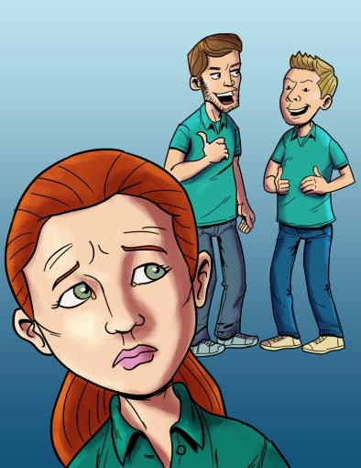
Teen Work Injuries
Anna’s Story
Job: Smoothie shop worker
Hazard: Sexual harassment
Injury: Emotional trauma
The Impact of Work Injuries
What could Anna's employer have done to stop her harasser?
What would you do in this situation?
How might Anna’s life be affected by this incident?
Notes:
Anna, age 15, worked in a smoothie and juice shop. One day, her 34-year-old manager, Dan, began making inappropriate
comments about Anna’s body in front of other employees. Dan also used foul language around her and told dirty
jokes. Though Dan’s behavior made her uncomfortable, Anna noticed that none of her co-workers seemed to have a
problem with it. Eventually, Dan began to brush against Anna when he walked past or put his arm around her shoulders or
waist. One night, Dan invited Anna to his house for dinner. When she refused, Dan became angry, accusing Anna of
being a “tease.” The next day, Anna got word that she had been fired from her job for “poor performance.” Anna felt
confused and upset. She blamed herself for what happened.

Slide 43
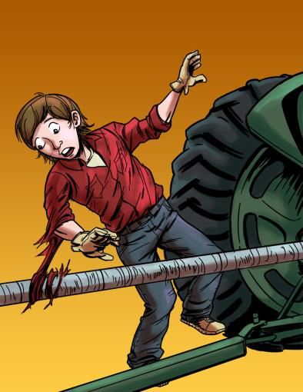
Teen Work Injuries
Logan’s Story
Job: Farm worker
Hazard: Unguarded, rotating bar on a tractor
Injury: Severed arm, broken neck
The Impact of Work Injuries
Why do you think this happened?
What could have prevented Logan from being injured?
How might this injury impact Logan’s daily life?
Notes:
Logan, a 14-year-old high school freshman, worked summers on his grandfather’s dairy farm. He often used a tractor to
pull the feed wagon, which had a large, turning screw that mixed the feed. The screw was connected by a metal bar
to a power source at the back of the tractor. The bar spun rapidly between the tractor and the wagon, and it was not
guarded. One day, Logan noticed a problem with the wagon. He left the tractor running and got off to get a closer look.
As Logan reached across the bar, his shirt sleeve got caught. Logan’s entire body quickly became wrapped around the
powerful, spinning shaft. Another farm employee saw what happened and rushed over to help. By the time the ambulance
arrived, Logan was unconscious. He woke up in the hospital
to discover that he had broken his neck and that his right arm
had been torn off at the shoulder

Slide 44
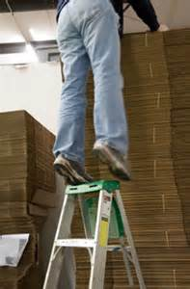
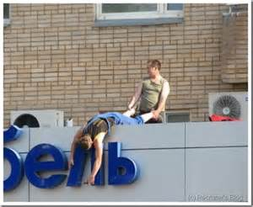
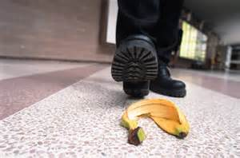
Workplace Hazard Recognition Exercise
https://www.osha.gov/hazfinder/game/index.html
Notes:
Hazards can be present on every job and employers have to identify the hazards, train the employees to recognize the hazards and protect employees from the hazards.

Slide 45
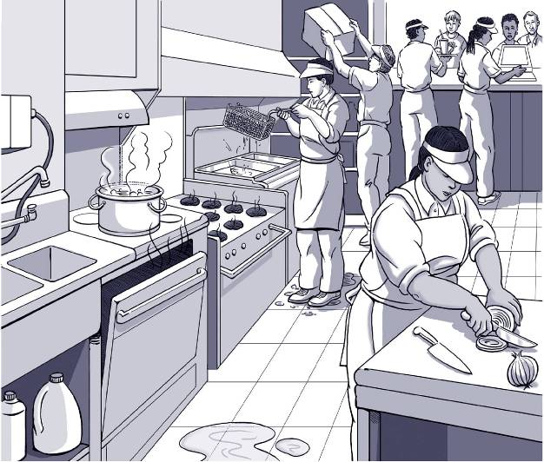
Find the Hazards: Fast Food
Notes:
Spills on the floor, oven door left open, stacking product over the head of a person, person at fryer with hot basket standing in a puddle, sharp knives, chemicals

Slide 46
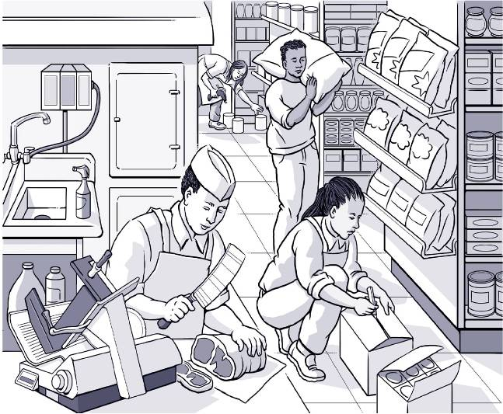
Find the Hazards: Grocery Store
Notes:
Heavy lifting, sharp knives, boxes in aisle way, awkward posture, chemicals

Slide 47
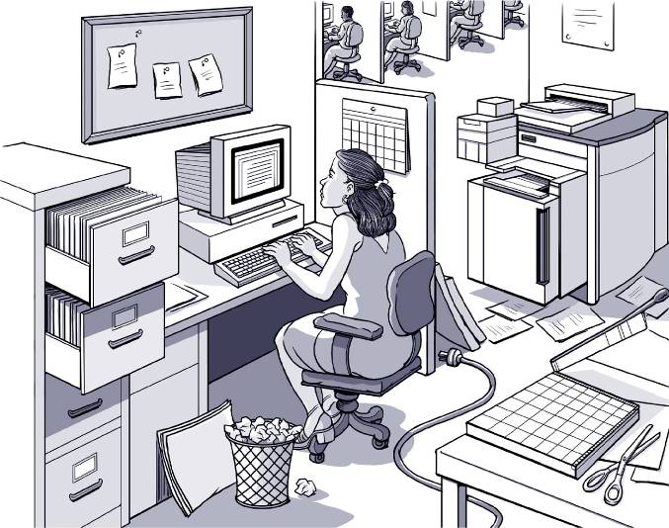
Find the Hazards: Office
Notes:
Awkward posture, cord across floor, file drawers not closed, trash can a trip hazard in its location, housekeeping,

Slide 48
Taking Action on Workplace Problems
Steps for approaching a workplace problem include: defining the problem; getting advice; choosing goals; knowing your rights; talking to your supervisor.
If you don’t feel comfortable talking with your boss, speak with a trusted adult, OSHA, or another agency.
Trust your instincts! Don’t be afraid to speak up if you have a problem at work!

Slide 49
Teen Workers Rights
Right to a safe and healthy workplace
Right to training about safety and health hazards, including information on chemicals and materials that could be harmful to your health
Right to protective clothing and equipment
Right to work without racial or sexual harassment
Right to refuse to work if the job is immediately dangerous to your life or health
Right to report safety and health problems to MIOSHA
Notes:
Direct attendees to review the Extreme Safety Rights Pamphlet.
Unlawful Sexual Harassment: Where to go for help:
Michigan Department of Civil Rights
(800) 482-3604
Listing of Office Locations
U.S. Equal Employment Opportunity Commission (EEOC)
McNamara Bldg., 8th Floor, 477 Michigan Avenue
Detroit, MI 48226
(313) 226-7636
Michigan Women's Commission
Suite 3-600
Detroit, MI 48202
(313) 456-4702
Definition of Sex Harassment:
Elliott-Larsen Civil Rights Act 453 of 1976 as Amended by Public Act 202 of 1980:
Sec 103(h) Discrimination because of sex includes sexual harassment which means unwelcome sexual advances, requests for sexual favors, and other verbal or physical conduct or communication of a sexual nature when:
(i) Submission to such conduct or communication is made a term or condition either explicitly or implicitly to obtain employment, public accommodations or public services, education, or housing.
(ii) Submission to or rejection of such conduct or communication by an individual is used as a factor in decisions affecting such individual's employment, public accommodations or public services, education, or housing.
(iii) Such conduct or communication has the purpose or effect of substantially interfering with an individual's employment, public accommodations or public services, education, or housing; or creating an intimidating, hostile, or offensive employment, public accommodations, public services, education, or housing environment.

Slide 50
Real Jobs, Real Risks
VIDEO & DISCUSSION
Notes:
Instructor determines use depending upon the time and the audience.
Youth Workplace Safety: It's Your Responsibility. Teens working and telling the importance of working safely. Run time 1 min 36 secs http://youtu.be/uaNE-MIPfgY
The instructor should make the following points:
It can happen to you.
There is no such thing as being careful enough. Many injuries are sustained doing relatively simple tasks.
Training on the hazards of a job should be done before an employee performs the job.
If you don’t know, say so!
Follow the safety rules and use the safety equipment

Slide 51

Teen Worker Responsibilities?
Follow your employer’s safety and health rules and wear or use all required gear and equipment
Follow safe work practices for your job, as directed by your employer / supervisor
Ask questions!
Tell your supervisor, boss, parent, or other adult if you feel threatened or endangered at work
Be aware of your environment at all times
Be involved in establishing or improving your worksite safety and health program
Trust your instincts
Notes:
These are responsibilities for the teen worker

Slide 52

Job Readiness Professionals Responsibilities
Consider safety when signing work permits and preparing young people for work.
Provide training and promote job safety.
Find out if the employer has an inspection history.
Encourage young workers to ask questions. Make sure young workers feel free to speak up.
Provide Information to Parents.
Notes:
Provide self-inspection checklist as a handout. Discuss the self-inspection checklist.

Slide 53
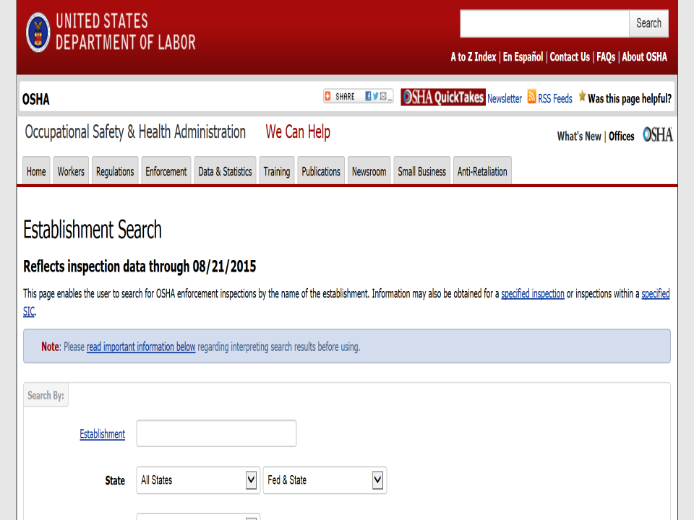
www.osha.gov/oshastats
Notes:
Anyone can obtain information on a company’s workplace safety history with MIOSHA. Go to www.osha.gov/oshastats
Click on establishment search

Slide 54
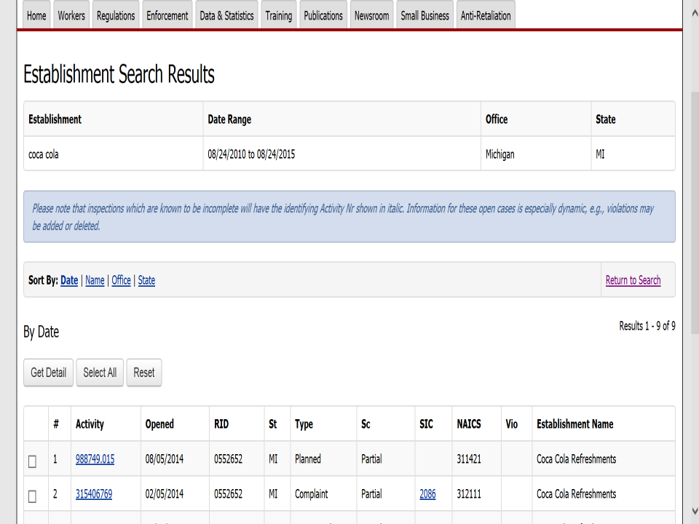
www.osha.gov/oshastats
Notes:
At the establishment page, type in the company name, state, select closed, and enter a date range. I suggest look at three years worth of history.

Slide 55
Notes:
This page will open and you simply click on the activity number to open up a report.

Slide 56
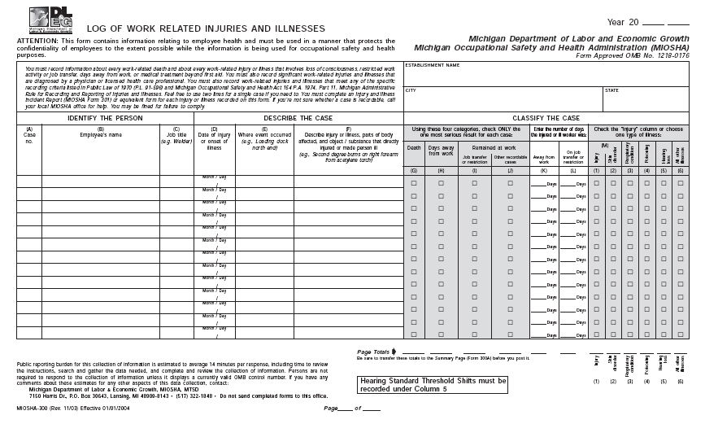
Notes:
The MIOSHA 300 form/Illness & Injury log is required to be maintained by all employers with 11 or more employees. This document is useful because it shows the types of injuries and illnesses that have been occurring at the company and in what job classifications and departments.
Cover the changes in Recordkeeping reporting requirements:
Eye loss
Amputations
Hospitalization of 1 or more

Slide 57
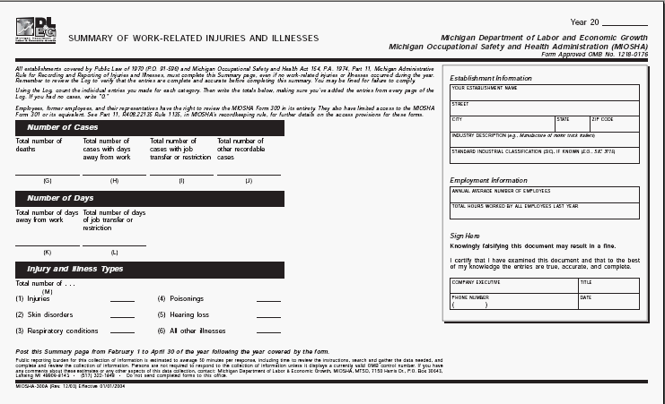
Notes:
MIOSHA 300 A Summary
Post between February 1 thru April 30 of the year following the year covered by the summary.

Slide 58
Employer Responsibilities
Give clear instructions for each task
Prepare and train workers for emergencies, violent situations, fires, etc.
Observe workers and correct any mistakes
Correct unsafe conditions.
Provide personal protective equipment
Provide training at the time of assignment and promote job safety
Encourage supervisors to set a good example
Obtain information about labor laws
Discuss onsite health and safety training for youth with job readiness counselors
Notes:
Give clear instructions for each task and give them an opportunity to ask questions
Correct unsafe conditions. Follow-up on issues reported by workers
Provide personal protective equipment and train young workers on how and when to use it
Encourage supervisors to set a good example and make sure young workers feel free to speak up

Slide 59

Young Worker Resources
Serve as a resource and advocate for preventing injury and illness in the workplace.
Discuss occupational health and safety regulations with employers
Investigate serious health and safety problems in the workplace.
  Call 1-800-866-4674 or
  visit the website at www.michigan.gov/miosha
  Like us on Facebook http://www.facebook.com/MichiganOSHA
Notes:
Federal OSHA, NIOSH, Department of Education/youth employment

Slide 60
MIOSHA Consultation Education
& Training Division
Onsite Consultation Program
Education and Training Program
Seminars and Workshops
Hazard Surveys
CET Publications Library
Free Video Loan Library
Self-Help Program
FREE
Notes:
Briefly explain all of the free services provided by CET.

Slide 61
Know Your Rights: Quiz Game
Questions
Rights on the Job | Dangerous Work and Work Permits | Child Labor Laws and Work Hours | Getting hurt, Getting help, Staying safe
$100
$100
$100
$100
$200
$200
$200
Some states require teens under 18 and still in school to get this before starting a job.
Click to close
It’s illegal for teens under 18
to operate these machines
(name 2).
Click to close
$200
These federal agencies handle complaints about workplace health and safety.
Click to close
Workers have rights on the job, including these (name 2).
Click to close
This type of insurance pays wages and medical benefits for workers hurt on the job. In exchange, the worker gives up the right to sue the employer.
Click to close
You can stay safe at work by doing these things (name 2).
Click to close
It’s illegal for teens under 18 to do these types of construction work (name 2).
Click to close
You have to be this old to operate a forklift.
Click to close
When you turn
this age, you aren’t protected anymore by child labor laws.
Click to close
Your employer must give you these health and safety protections on the job
(name 2).
Click to close
MI law says that this is
the latest time teens 16 and 17 can work on school nights.
Click to close
MI law says that this is
the maximum number of hours 14- and 15- year-olds can work in a school week.
Click to close
These laws protect teens from
working too long, too late,
or too early.
Click to close
These are two rights you
have if you’re hurt on the job.
Click to close
This federal agency handles complaints about wages and work hours.
Click to close
MI law says that
14- and 15-year-olds can
work until this time on
a school night.
Click to close
It’s illegal for your employer to punish you for doing this
(name 1).
Click to close
It’s illegal for 14-and 15-year olds to do some jobs, including these (name 2).
Click to close
The law says that
your employer must pay you this amount per hour, your state’s minimum wage.
Click to close
If you are hurt at work, you should take these steps
(name 2).
Click to close
$300
$300
$300
$300
$400
$400
$400
$400
$500
$500
$500
$500
Notes:
Fun Review game covering MIOSHA and Youth Labor Law requirements. Use if time permits.

Slide 62
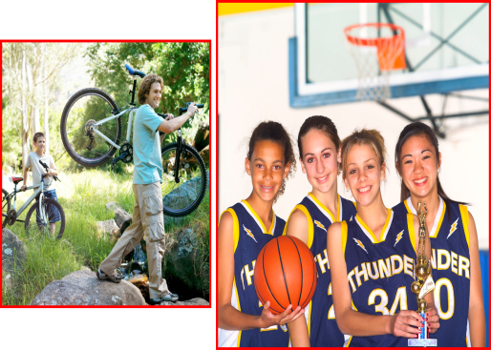
Thank You For Attending This Presentation
Notes:
The video clip is a fun song about safety. It was featured on several national news programs. Optional for the instructor to use it. It does not play automatically in the slideshow.

